Slide 1
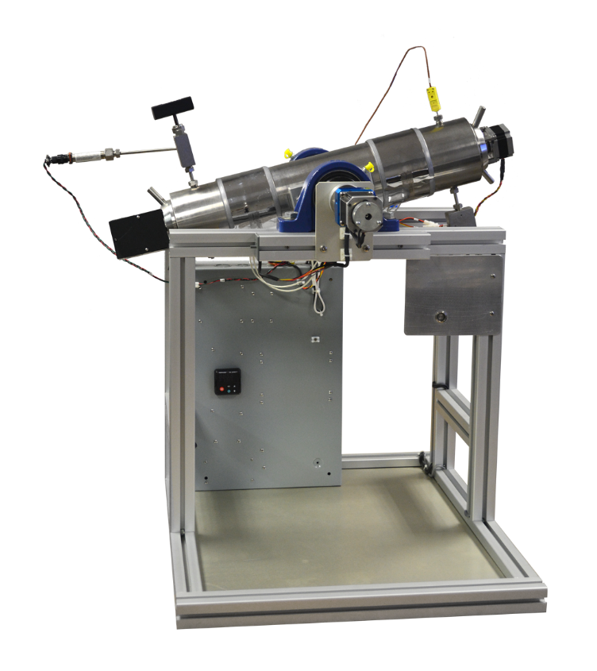
Grace instrument
M9700 HPHT PVT System

Slide 2
PVT system provides accurate, repeatable results
The Grace Instrument M9700 HPHT PVT System is designed to study the phase behavior of hydrocarbon fluids. The system is mercury-free, featuring a hydraulic syringe pump which generates the required pressure for testing. Test fluid volume is monitored for expansion or contraction while under varying conditions of pressure, volume, and temperature (PVT). These conditions are computer-controlled and are completely customizable through user-designed test sequences created with the included PC software; the M9700’s software is installed on a Windows PC that is included with the machine. This multifunctional system can also perform as a recombination cell.

Slide 3
M9700 HPHT PVT System’s hardware
The M9700 HPHT PVT System uses a syringe pump to push its piston, resulting in a compact and less expensive PVT system. Its hydraulic piston controls the pressure and volume in the cell.

Slide 4
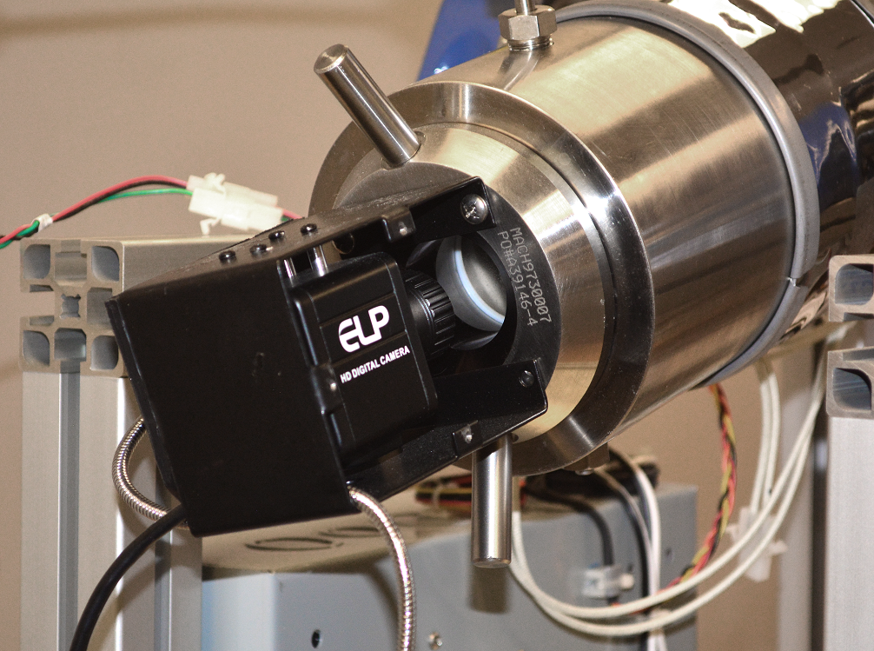
M9700 PVT System’s hardware
The PVT’s pressure cell features a transparent sapphire window on one end, allowing visual observation of the sample fluid during a test. All M9700s come with a camera that can be mounted to it, so a live video feed can be displayed on our custom software as it records video.

Slide 5
M9700 PVT System’s hardware
The M9700 HPHT PVT System can pressurize and heat the fluids while stirring them. The system does so using a magnetic stirrer and an automatic rocking system.

Slide 6
Multiple test options for comprehensive PVT testing
The M9700 HPHT PVT System gives the operator the greatest possible number of options for testing parameters. Extremely high-resolution measurement of pressure, temperature, phase, vapor, liquid volume, gas volume, and more can all be tracked accurately and repeatably by the computer-controlled sensors and the state-of-the-art data analysis software that powers the entire system.

Slide 7
Multiple test options for comprehensive PVT testing
The PVT System can perform many tests, including: constant mass expansion (CME) tests, constant mass depletion (CMD) tests, differential vaporization (DV) studies, constant volume depletion (CVD) tests, swelling tests, separator tests, and more. During test operations, the software records test data, including: pressure, total volume, retrograde liquid volume, and temperature. The recorded data can be exported in .CSV format into a spreadsheet file to derive the PVT parameters.

Slide 8
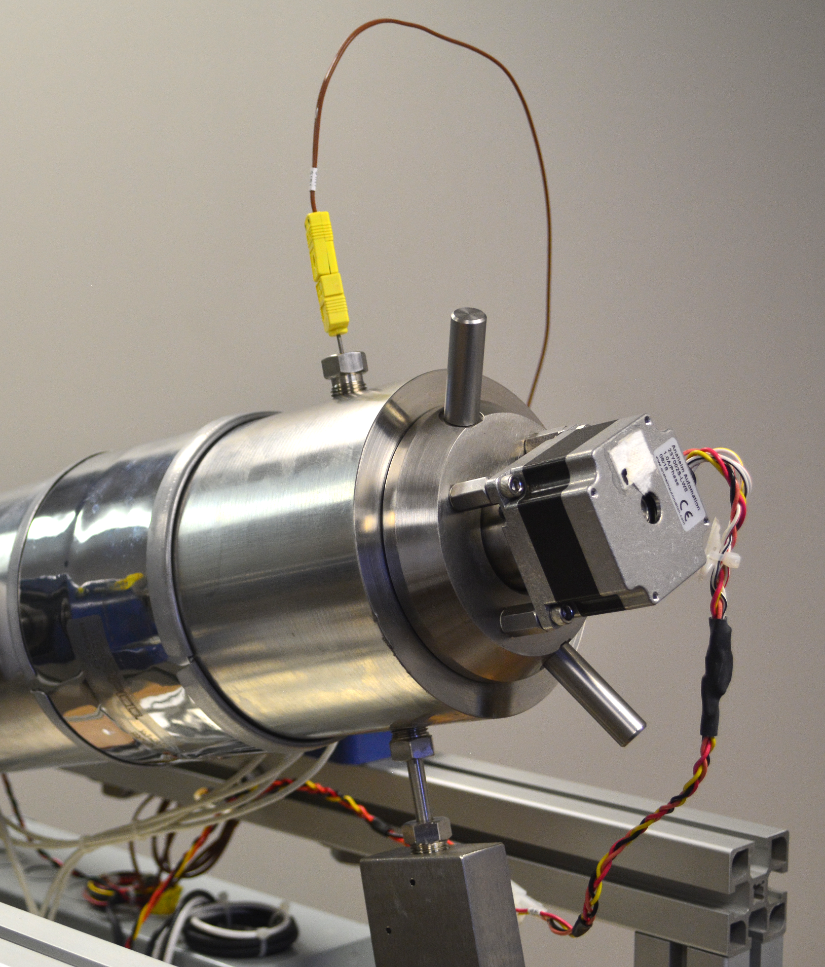
Multi-Functional instrument
PVT system
Fully-functional recombination cell

